Slide 1
Conceptualizing and Measuring Resilience
Christopher B. Barrett, Cornell University
CEAR/Huebner Conference 6th Annual Summer Risk Institute
Georgia State University, Atlanta
July 25, 2019

Slide 2
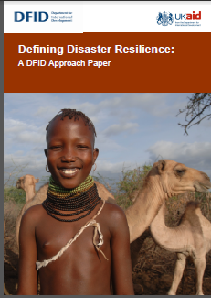
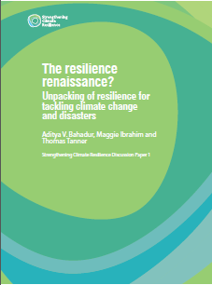
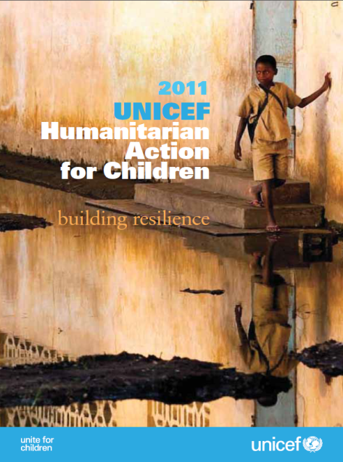
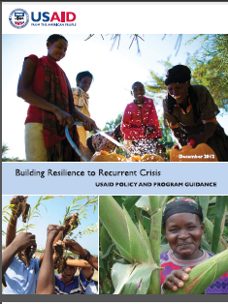
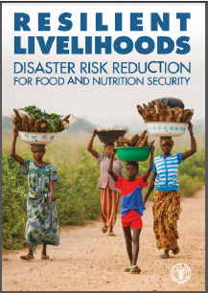
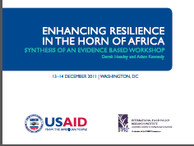
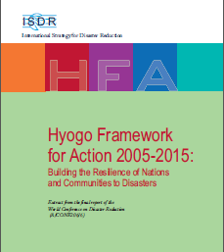
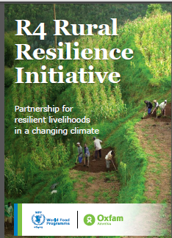

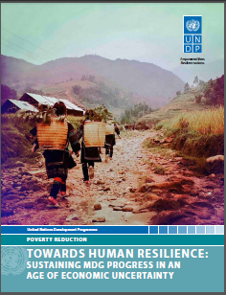

Motivation
“Resilience” has rapidly become a ubiquitous buzzword, but ill-defined concept within the development and humanitarian communities

Slide 3

Motivation
Why development and humanitarian communities’ current fascination with “resilience”?
Risk perceived increasing in both frequency and intensity
Recurring crises lay bare the longstanding difficulty of reconciling humanitarian response to disasters with longer-term development efforts.
Increasingly recognize interdependence of biophysical and socioeconomic systems. Tap ecological work on resilience.
But concept remains unclear …
and thus so too measurement.

Slide 4
Motivation
Close parallels to multiple other literatures :
  System-focused
  About the capacity to absorb, and adapt to, disturbances/ shocks w/o changing state
But must adapt concept to be useful for development:
  We care about individual well-being — the system has instrumental rather than intrinsic importance
  Must be pro-poor, and hence explicitly normative
  Stability not always good; may instead seek productive disruption
Need to adapt ecological resilience lit using existing tools of development studies/economics concerning the stochastic
dynamics of individual and collective human well-being.

Slide 5
Motivation
At the same time, much ambivalence (even cynicism) about the ‘rise of resilience’
Seen as too imprecise and malleable a concept/term
Not necessarily pro-poor as commonly formulated
Often ignores issues of agency/power/rights
To be useful, we need a theory-and-evidence-based understanding of:
what resilience is with respect to human well-being
how to measure/estimate it
what to do to effectively promote resilience so as to shock-and-stress-proof sustainable advances in living standards among the poor and vulnerable.

Slide 6
Toward A Theory of Development Resilience
“Development resilience is the capacity over time of a person, household or other aggregate unit to avoid poverty in the face of various stressors and in the wake of myriad shocks. If and only if that capacity is and remains high, then the unit is resilient.”
Refined/agreed by FSIN (2014) as “capacity that ensures adverse stressors and shocks do not have long-lasting adverse development consequences”

Slide 7
Toward A Theory of Development Resilience
Focus on minimizing individual human experience of ill-being over time in a stochastic world.
Implies:
focus on individuals’ (and groups’) well-being within a system, not the state of a system itself.
consider the stochastic dynamics of well-being
Focus less on specific sources of risk b/c problem is uninsured exposure to many stressors (ex ante risk) and shocks (ex post, adverse outcomes). Resilience implies adaptability while staying/becoming non-poor.

Slide 8
Toward A Theory of Development Resilience
Stochastic Well-Being Dynamics
Consider the moment function for conditional well-being:
m^{k}(W_{t+s} | W_{t}, ε_{t})
where m^{k} represents the k^{th} moment (e.g., mean (k=1), variance (k =2) or skewness (k =3)
W_{t} is well-being at time t
ε_{t} is an exogenous disturbance (scalar or vector) at time t
These moment functions describe quite generally, albeit in reduced form, the stochastic conditional dynamics of well-being.
Much like ‘poverty’ measurement, ‘resilience’ holds when the time path of conditional probabilities of well-being are sufficiently high by some normative criteria (pov & prob lines).

Slide 9
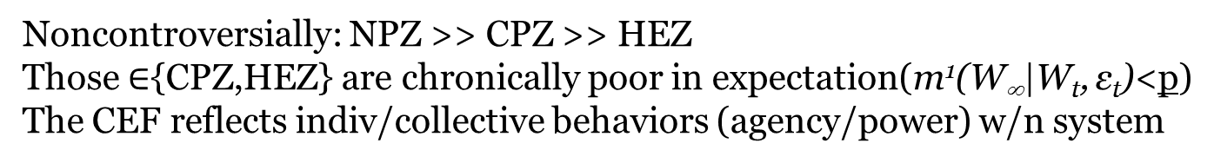
Toward A Theory of Development Resilience
Ex: Nonlinear expected well-being dynamics with multiple stable states (m¹(W_{t+s} | W_{t}, ε_{t}) )
Noncontroversially: NPZ >> CPZ >> HEZ
Those $∈${CPZ,HEZ} are chronically poor in expectation(m¹(W∞|W_{t}, ε_{t})<p)
The CEF reflects indiv/collective behaviors (agency/power) w/n system

Slide 10
Toward A Theory of Development Resilience
The development ambition is to move people into the non-poor zone and keep them there.
The humanitarian ambition is to keep people from falling into HEZ … offers foundation of a rights-based approach to resilience.
For the current non-poor, seek resilience/resistance against shocks in the ecological sense: no shift to either of the lower, less desirable zones.
But for the current poor, those in HEZ/CPZ, the objective is productive disruption, to shift states to the NPZ.
Asymmetry is therefore a fundamental property of resilience against chronic poverty. Thus stability ≠ resilience.

Slide 11
Toward A Theory of Development Resilience
Explicitly incorporate risk by integrating broader set of moment functions to move from CEF to CTDs:
Note: Transitory shocks (- or +) can have persistent effects
Risk endogenous to system state
CTDs reflect both natural and socioeconomic contexts

Slide 12
Programming implications
Objective: minimize the duration, intensity and likelihood of people’s experience of poverty
Three options:
Shift people’s current state – i.e., increase W_{t}. Ex: transfers of cash, education, land or other assets.
Alter CTDs directly through risk reduction/transfer (∆s system too) – i.e., truncate ε_{t} . Ex: social protection - EGS, insurance, improved policing, drought-resistant varieties.
Change the underlying system structure (m^{k}(.) – techs/ institutions – induces ∆ in behaviors and CTDs. Prob: multi-scalar reinforcement – ‘fractal poverty traps’
Should explore the feedback within broader system to identify possible intervention points behind univariate dynamics.

Slide 13
Toward Measurement and Evaluation
If agencies program around resilience goals, then we need to be able to measure it and evaluate program/project performance. Should use theory to guide measurement.
Key measurement implications of this theory:
Qual. work to better understand root relationships.
Estimate m^{k}(·)
Use estimated moments to estimate the probability of poverty in each of a sequence of time periods.
Based on a normative assessment of an appropriate tolerance level for the likelihood of being poor over time, individuals, households, communities, etc. could be classified as resilient or not.
Then do impact evaluation based on such measures.

Slide 14
Toward Measurement and Evaluation
If agencies program around resilience goals, then we need to be able to measure resilience & evaluate program/project performance. Should use theory to guide measurement.
Core challenge: resilience is unobservable, a latent variable.
This raises data challenges: need micro-scale panels, ideally high frequency (e.g., from sentinel sites) to capture seasonality and a range of shocks/stressors.

Slide 15
Cissé-Barrett method
Cissé & Barrett (JDE 2018) Approach To
Development Resilience Estimation
Apply Barrett & Constas (PNAS 2014) probabilistic, cond moments-based estimation of well-being dynamics
Like poverty estimation, a normative method. Assume:
(i) Level – Minimum acceptable standard of well-being (outcome) for individual or household.
  (ii) Probability – Minimum acceptable likelihood of meeting level criterion
  Development resilience is sufficient prob. of attaining an adequate standard of living (given shocks and stressors)
  Aggregable/decomposable, like FGT poverty measures.

Slide 16
Estimate conditional moments of the well-being outcome of interest (W), as a function of variables reflecting:
(i) Observable exogenous shocks (e.g., drought, cyclone), S
(ii) conditioners of exposure, recovery (e.g., gender), X
(iii) interventions (plausibly exog., if evaluating), I;
Interact with shocks if targeted intervention.
(iv) polynomial lags of DV and shocks (i.e., possible nonlinear dynamics and cumulative, delayed response)
Cissé-Barrett method

Slide 17
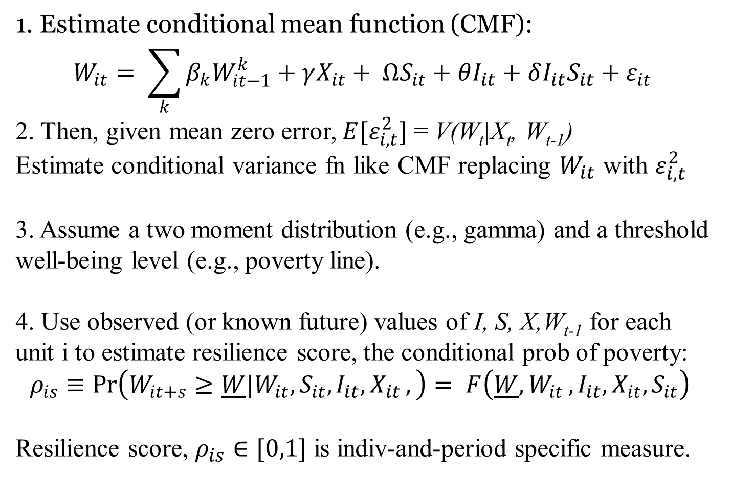
Cissé-Barrett method
1. Estimate conditional mean function (CMF):
$$W_{it}= \sum_{k}{{β_{k}W}_{it−1}^{k}}+γX_{it}+ ΩS_{it}+{θI_{it}+δI_{it}S_{it}+ε}_{it}$$
2. Then, given mean zero error, $E[ε_{i,t}^{2}]$ = V(W_{t}|X_{t}, W_{t-1})
Estimate conditional variance fn like CMF replacing $W_{it}$ with $ε_{i,t}^{2}$
3. Assume a two moment distribution (e.g., gamma) and a threshold well-being level (e.g., poverty line).
4. Use observed (or known future) values of I, S, X,W_{t-1} for each unit i to estimate resilience score, the conditional prob of poverty:
$$ρ_{is}≡\operatorname{Pr}\left(W_{it+s}≥\underline{W}|W_{it}, S_{it}{,I_{it},X}_{it},\right)= F\left(\underline{W}{,W}_{it}, {I_{it},X}_{it}, S_{it}\right)$$
Resilience score, $ρ_{is}∈[0,1]$ is indiv-and-period specific measure.

Slide 18
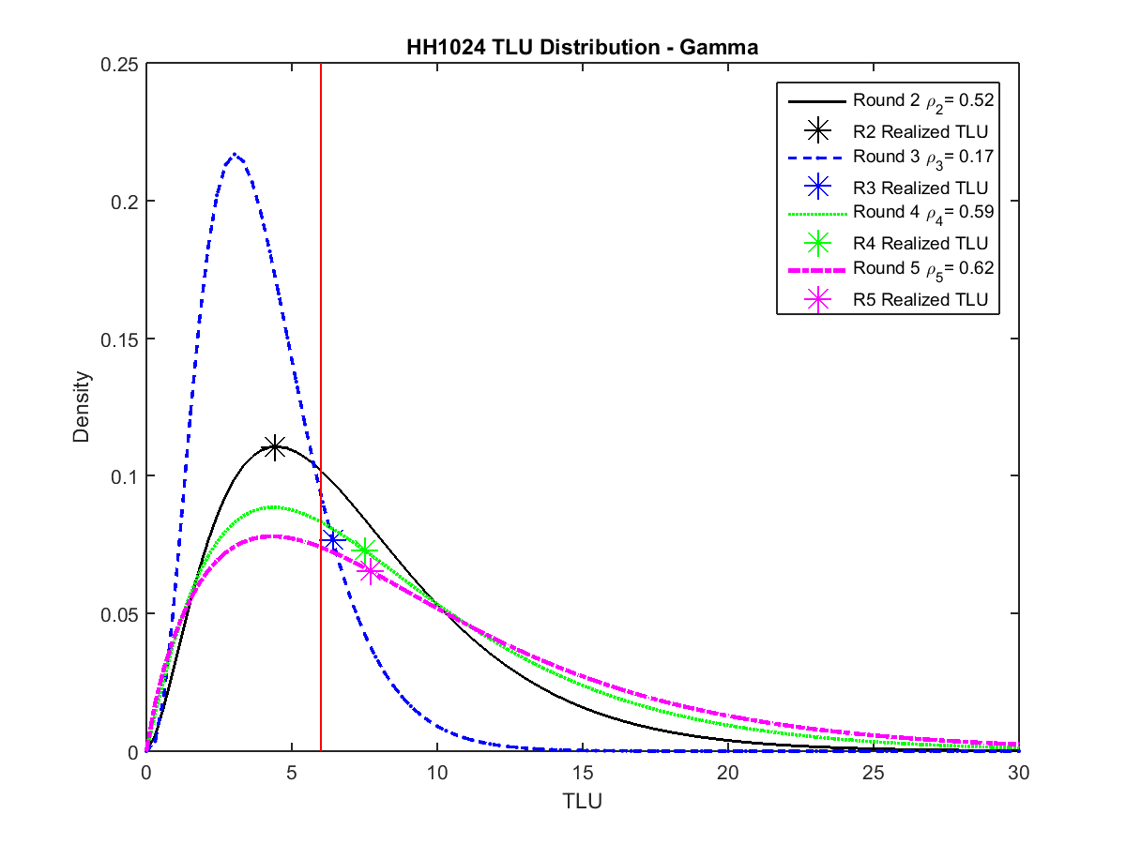
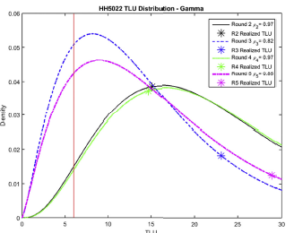
HH-period-specific CPDs:
Cissé-Barrett method
Example from northern Kenya pastoralists
Source: Cissé & Barrett JDE 2018

Slide 19
HH-period-specific CPDs: Population-level measures:
Cissé-Barrett method
Example from northern Kenya pastoralists
Source: Cissé & Barrett JDE 2018

Slide 20
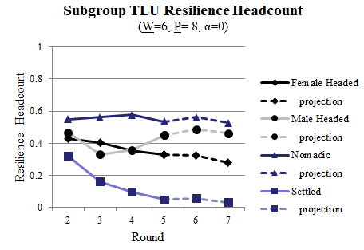
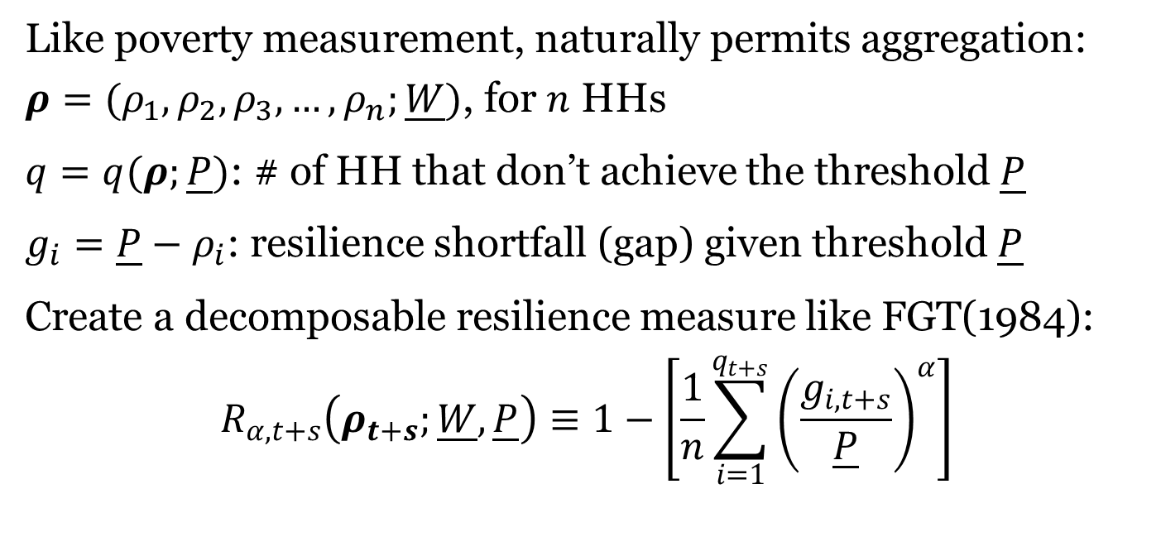
Cissé-Barrett method
Like poverty measurement, naturally permits aggregation:
$ρ=(ρ_{1},ρ_{2},ρ_{3},…,ρ_{n};\underline{W})$, for $n$ HHs
$q=q(ρ;\underline{P})$: # of HH that don’t achieve the threshold $\underline{P}$
$g_{i}=\underline{P}−ρ_{i}$: resilience shortfall (gap) given threshold $\underline{P}$
Create a decomposable resilience measure like FGT(1984):
$$R_{α, t+s}\left(ρ_{t+s};\underline{W},\underline{P}\right)≡1−\left[\frac{1}{n}\sum_{i=1}^{q_{t+s}}{{\left(\frac{g_{i,t+s}}{\underline{P}}\right)}^{α}}\right]$$
Example from northern Kenya pastoralist households
Source: Cissé & Barrett JDE 2018

Slide 21
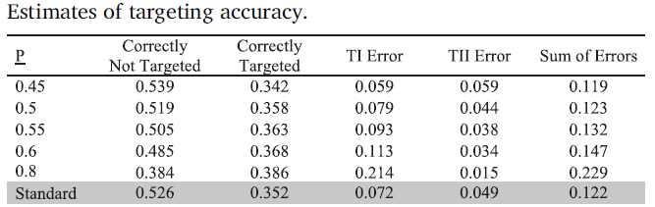
Cissé-Barrett method
Some appealing features of the C-B method:
1. Permits targeting adjustment, trading off TI/TII errors. Can also outperform standard targeting based on most recent observation of well-being outcome by taking stochasticity of outcomes into consideration.

Slide 22
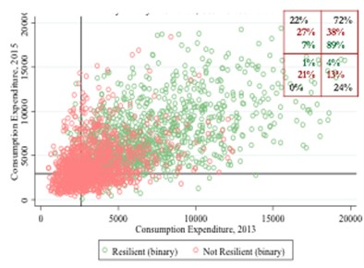
Cissé-Barrett method
In Niger LSMS panel data, does reasonably well in predicting out of sample expenditure fluctuations
Source: Upton, Constenla & Barrett (2019)

Slide 23
Cissé-Barrett method
2. Lends itself naturally to impact evaluation
Example: Heifer Int’l project in Zambia.
Training and asset transfers significantly increase conditional mean and reduce conditional variance of household wealth over time. Total B/C ~ 7
[2.5,8.7] across hh wealth deciles
Source: Phadera et al. (JDE 2019)

Slide 24
Cissé-Barrett method
3. Can use same methods with food intake indicators as dep vars. Satisfies axioms of 1996 World Food Summit food security definition.

Slide 25
Cissé-Barrett method
4. Far outperforms the factor analysis-based Resilience Capacities Index (RCI) methods of FAO (RIMA) and USAID (TANGO), which are not even internally consistent in their measures!
Source: Upton, Constenla & Barrett (2019)

Slide 26
Summary
Resilience is a popular buzzword now. But little precision in its use, theoretically or methodologically. That makes learning about ‘building resilience’ quite difficult.
Theory, data, and methods are emerging to enable rigorous, precise use of the concept to identify how best to avoid and escape chronic ill-being. Initial results promising for descriptive/predictive purposes as well as impact evaluation.
Much to do in all areas … a massive research agenda, especially as agencies begin using resilience as a programming principle.
But we must start with a firm theoretical foundation and build measures/data that directly follow theory.

Slide 27
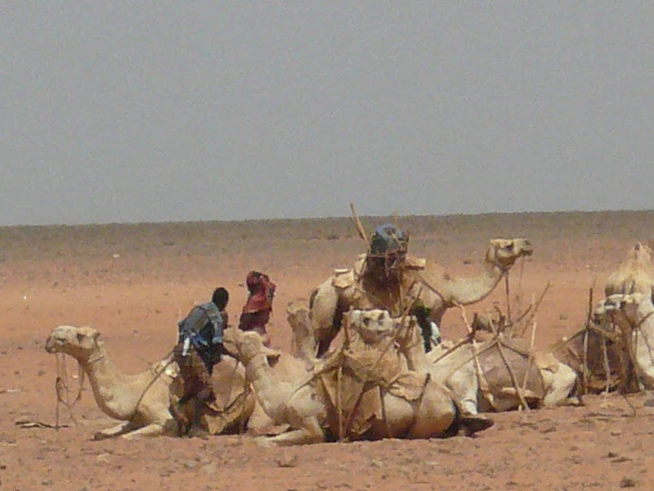
Thank you
Thank you for your time, interest and comments!

